Slide 1

After School MATH LABS
draft concept
Gian Marco Miccio

Slide 2
DESIGN PHILOSOPHY
Make it interesting
introduce a stake, a reason for them to care about it
Discuss and predict before experiment
come up with ideas collectively
ask: what do we expect? how do you think it will play out
Gamefy
emphasis on collaboration
make the task entertaining
Diverse explanation
introduce the concept from multiple angles
Build upon concepts
start with easy, end with difficult

Slide 3

EXAMPLE LAB - PROBABILITY

Slide 4
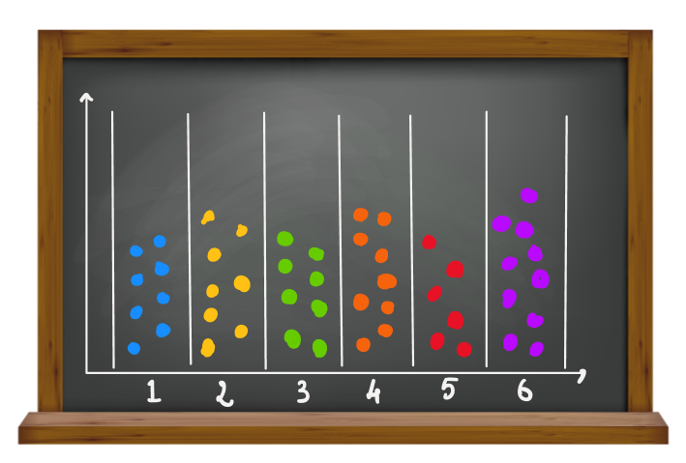
Combinatorics and Dice Probabilities
Introduce the concept of equally as likely
start with simple coin toss
Throw of DICE
discuss about probability of the numbers
EXPERIMENT
everyone throws dice and collect the numbers
create a board with columns: insert a token or draw a point for every time a number comes up
show that with a lot of repetition all of them have about the same number of points

Slide 5
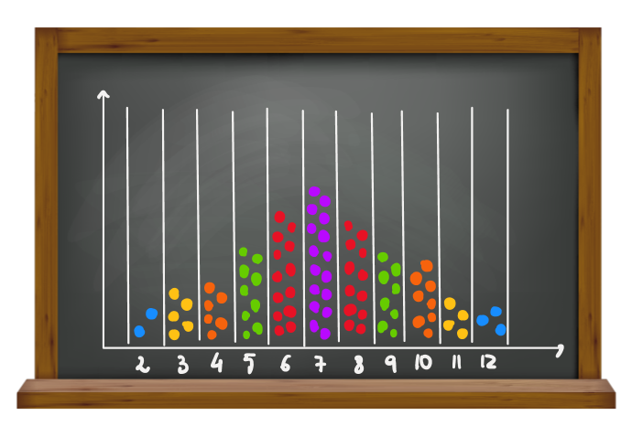
Combinatorics and Dice Probabilities
Introduce the concept of MORE likely
bag of marbles with 10 blue and 2 red -> what are we going to draw?
Throw of TWO DICE
discuss about the probabilities of each sum combination ->are they the same of is one number more likely?
draw a board of all 36 combinations
EXPERIMENT
work in PAIRS: throw one dice each, then sum and collect the numbers
new board with columns: insert a token or draw a point for every time a summed number comes up
show that 7 is more likely, 2 and 12 are the least likely

Slide 6
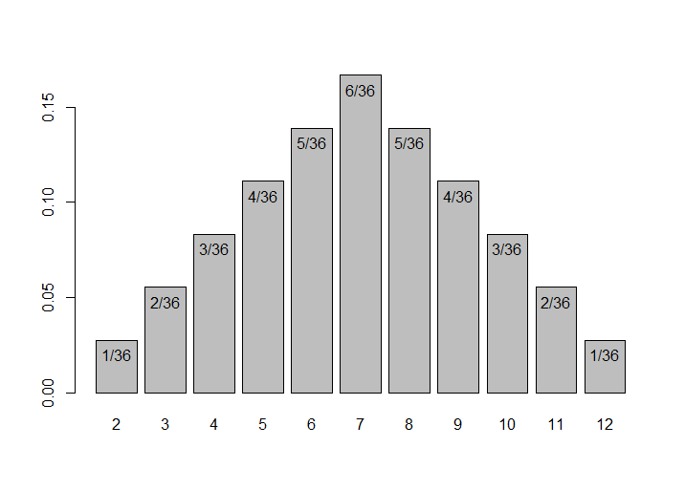
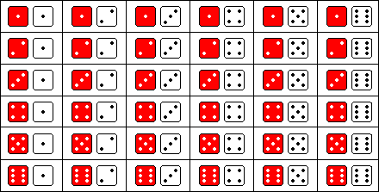
Core Concepts
Probability measure
Concept of how likely something is
Probability Distribution
Columns with points
Random Variable
Layout of all possible events

Slide 7

Other Topics
Geometry
Concept of a variable
Possibly Physics:
Archimede’s principle
Collisions
Forces
Basic Trigonometry
Cosine and Sine

Slide 8
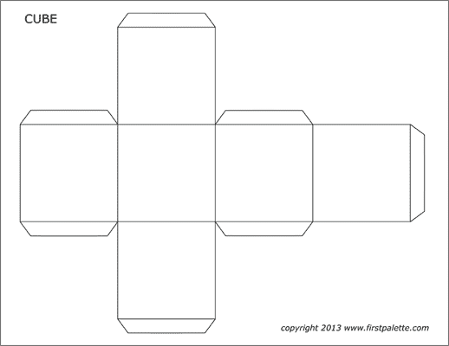
Possible Modifications
Expand on Concept:
what if we want to see the probability of getting at least 8? Move around the points on the board
Discuss difficulty:
simplified explanation and omission of the all-events chart
More playful/light approach:
if the kids are really young, maybe create the dice together with cut prints of cubes
Different topics
introduce different concepts that teachers may found important/relevant

Slide 9
Contact Information
Gian Marco Miccio
Bachelor degree in Mathematical Engineering at Politecnico di Milano
Master’s degreee student in Mathematical Sciences at NTNU
email: micciogianmarco01@gmail.com
phone number: +39 3463536382

